Slide 1
Lecture 7
The Body as an
Instrument of the Self

Slide 2
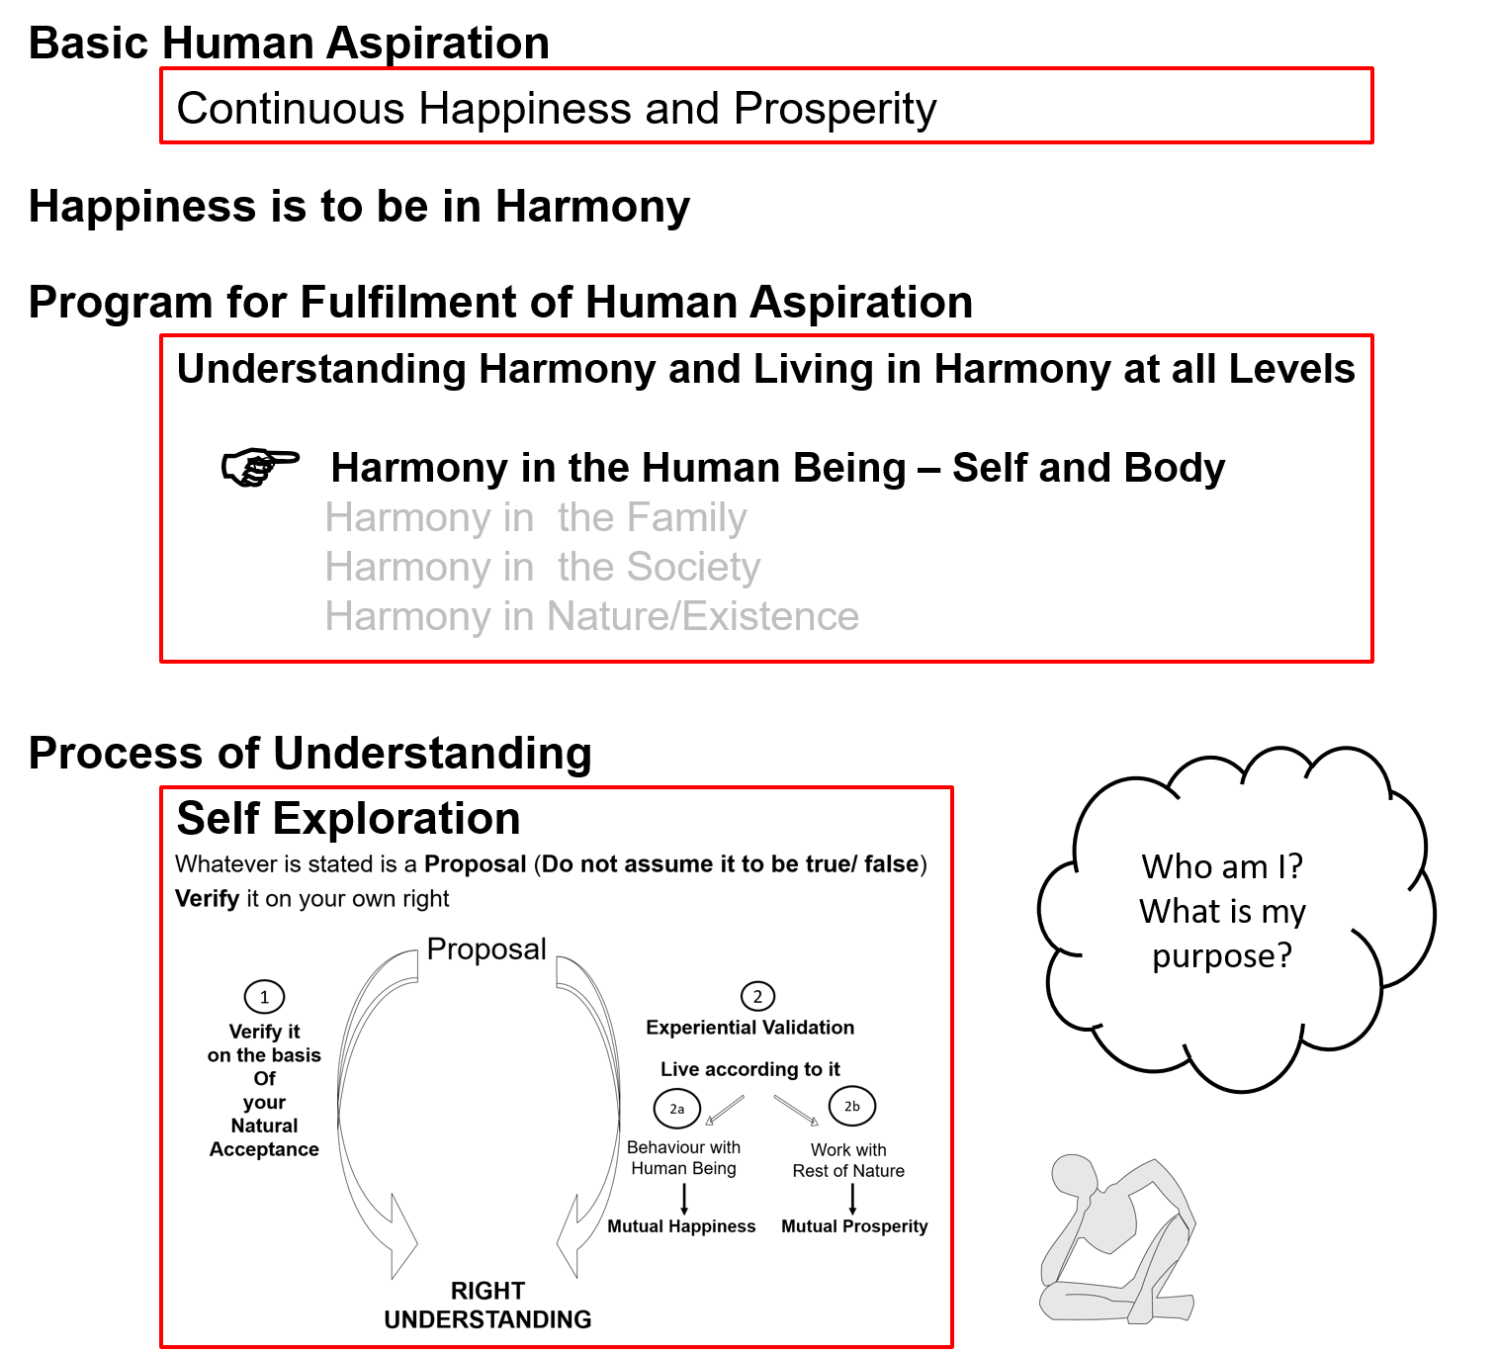

Slide 3
Human Being Ekkuo | Self eSa | Body “kjhj
Need vko';drk | Happiness (e.g. Respect) lq[k ¼tSls lEeku½ | Physical Facility (e.g. Food) lqfo/kk ¼tSls Hkkstu½
In Time dky esa | Continuous fujUrj | Temporary lkef;d
In Quantity ek=k esa | Qualitative (is Feeling) xq.kkRed ¼Hkko gS½ | Quantitative (Required in Limited Quantity) Ekk=kRed ¼lhfer ek=k esa½
Fulfilled By iwfrZ ds fy, | Right Understanding & Right Feeling lgh le>] lgh Hkko | Physio-chemical Things HkkSfrd&jklk;fud oLrq
Activity fØ;k | Desire, Thought, Expectation… bPNk] fopkj] vk”kk--- | Eating, Walking… [kkuk] pyuk---
In Time dky esa | Continuous fujUrj | Temporary lkef;d
Response | Knowing, Assuming, Recognising, Fulfilling tkuuk] ekuuk] igpkuuk] fuokZg djuk | Recognising, Fulfilling igpkuuk] fuokZg djuk
 | Consciousness pSrU; | Material tM+
Co-existence
lgvfLrRo

Slide 4
Self Body
Consciousness |  | Material
INFORMATION
Instruction
Sensation

Slide 5
Self Body
Consciousness |  | Material
I am |  | My body is
I want to live |  | My body is used as an instrument
INFORMATION
Instruction
Sensation

Slide 6
Self Body
Consciousness |  | Material
I am |  | My body is
I want to live |  | My body is used as an instrument
I want to live with continuous happiness |  | Physical facility is required for nurturing, protection and right utilization of the body
To understand and to live in harmony at all levels of being (from self to entire existence) is my program of action for continuous happiness |  | Production, protection and right utilization of physical facility is a part of my program (<1/4th)
INFORMATION
Instruction
Sensation

Slide 7
Self Body
Consciousness |  | Material
I am |  | My body is
I want to live |  | My body is used as an instrument
I want to live with continuous happiness |  | Physical facility is required for nurturing, protection and right utilization of the body
To understand and to live in harmony at all levels of being (from self to entire existence) is my program of action for continuous happiness |  | Production, protection and right utilization of physical facility is a part of my program (<1/4th)
I am the: Seer, Doer, Enjoyer (Experiencer) nz’Vk] drkZ] HkksDrk |  | I use the body as an instrument for fulfillment my program
INFORMATION
Instruction
Sensation

Slide 8
I am the Seer
“Seer” means the one that sees / understands
e.g. If you are given something in your hand and you conclude that it is a pen, it is not your eyes that concluded this. It is you that concluded this. The Self sees via the eyes – the eyes don’t see themselves
Like that all the 5 senses are just the instrument that enable the Self to see something outside
Just like you see outside, you can also see ‘within’, without using the body for sensation
e.g. You can ‘see’ that you are feeling happy, getting angry...
Thus, the Self ‘sees’ or understands, sometimes with the help of the body, sometimes without the help of body
The Body is used as an instrument

Slide 9
I am the Doer
“Doer” means the one that does, who takes decision to do
I am the one who decides. I decide what to do, what not to do...
I may or may not use the body to do – what I think of is my decision. I do that thinking within myself (there is no role of the body in this)
If required, the body is used to express my decision
The Body is used as an instrument

Slide 10
I am the Enjoyer (Experiencer)
“Enjoyer” means the one that experiences happiness / unhappiness
I am the one that feels enthused or depressed. I am the one that feels angry or delighted...
I am the enjoyer, the experiencer
The Body is used as an instrument

Slide 11
Self Body
Consciousness |  | Material
I am |  | My body is
I want to live |  | My body is used as an instrument
I want to live with continuous happiness |  | Physical facility is required for nurturing, protection and right utilization of the body
To understand and to live in harmony at all levels of being (from self to entire existence) is my program of action for continuous happiness |  | Production, protection and right utilization of physical facility is a part of my program (<1/4th)
I am the: Seer, Doer, Enjoyer (Experiencer) nz’Vk] drkZ] HkksDrk |  | I use the body as an instrument for fulfillment of my program
INFORMATION
Instruction
Sensation
The Self is
central to human existence
The Body is
an instrument of the Self

Slide 12
Sum Up
Human Being is co-existence of Self and Body
The Self is the seer, doer and enjoyer – it is central to human existence
The need of the Self is continuous happiness
For this, the program of the Self is:
To understand harmony &
To live in harmony
Production, protection and right utilization of physical facility is a part of my program (<1/4th)
The Body is an instrument of the Self
The transaction between Self and Body is only in the form of information
at all levels of being
  As an individual human being
  As a member of the family
  As a member of society
  As an unit in nature/existence

Slide 13
Self Reflection

Slide 14
Self Reflection
Find out if you (self) decide what to do or your body decides what to do
Which is the higher priority for you – your self or your body?
Can you see that you use your body as an instrument to fulfill your desires (right or wrong desires)?

Slide 15
Questions

Slide 16
FAQ
It has been scientifically proven that the brain controls the body. So is the brain the self?
I thought seeing is through the senses only. You are saying that we can see without the use of sensation also. It does make sense. Please explain what is the full meaning of seeing?
When we want to convey something to another person, we use some words or some gestures, some drawing… something to convey the meaning of what we want to convey. So isn’t there always a role of sensation in communicating?

Slide 17
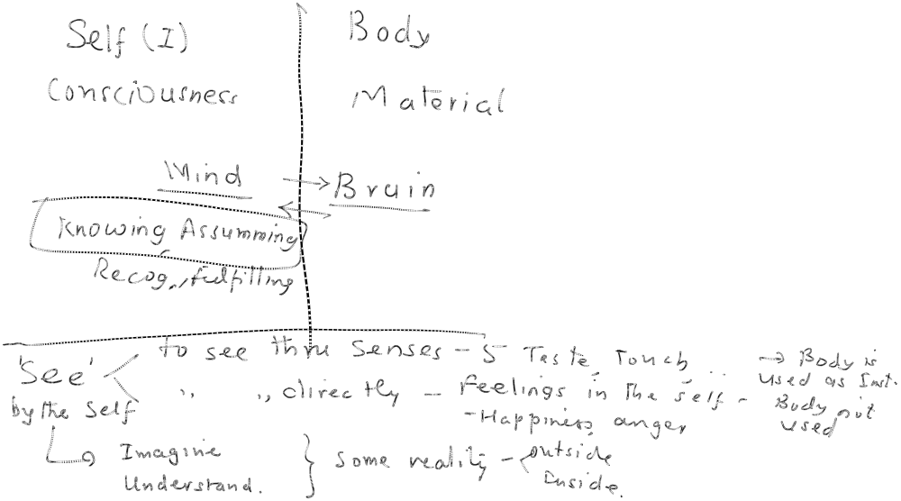
Ans 1: Brain & Self

Slide 18
Ans 2: Seeing

Slide 19
Ans 3: Communicating
HB1 HB2
Sees a → gives a name ---→ word is heard → sees reality R2
Reality (word) If R2 = R1, then communication is successful
R1 If R2 NEQ R1, then communication failed

Slide 20
Communicating
Conception
Reality Name (word)
Representing
Bigger Reality Sentence (collection of words)

Slide 21
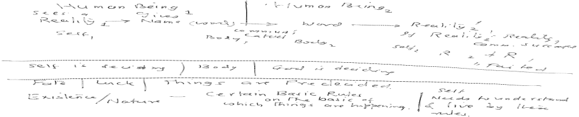
Ans to other questions

